Slide 1


Single-Cell Transcriptomics Reveals Pre-existing COVID-19 Vulnerability Factors in Lung Cancer Patients
Wendao Liu
Advisor: Dr. Zhongming Zhao
5/4/2024

Slide 2
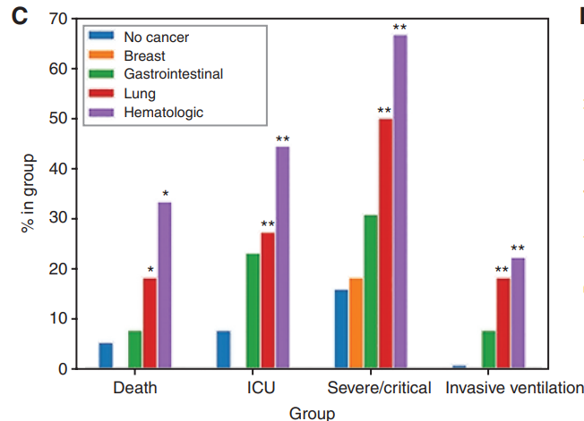
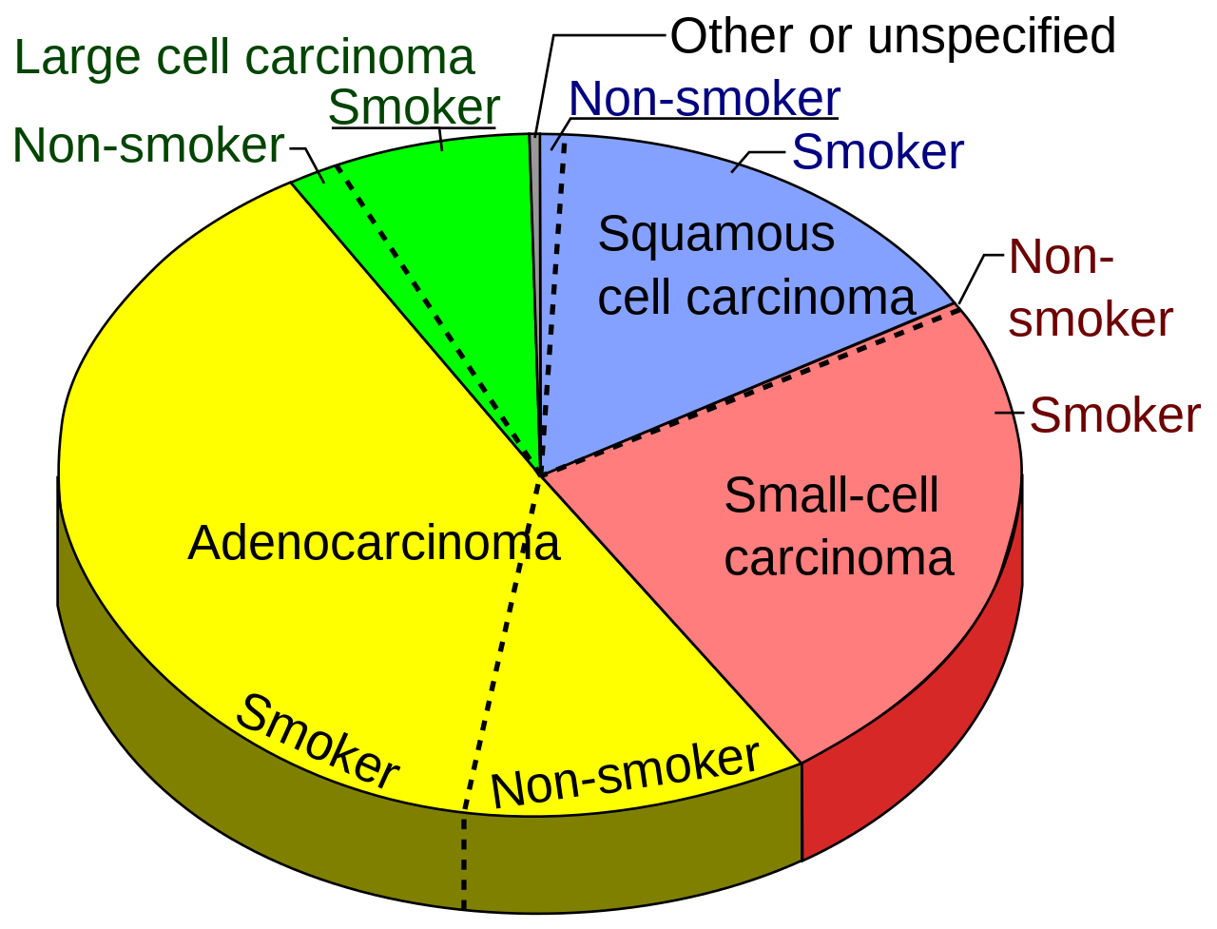
Background: COVID-19 and cancer
.
Cancer patients are more vulnerable to COVID-19, even if vaccinated
The association between cancer and COVID-19 is established, but the molecular mechanism requires further investigation
Dai et al. Cancer Discov. 2020
Schmidt et al. Ann Oncol. 2022
Wikipedia

Slide 3
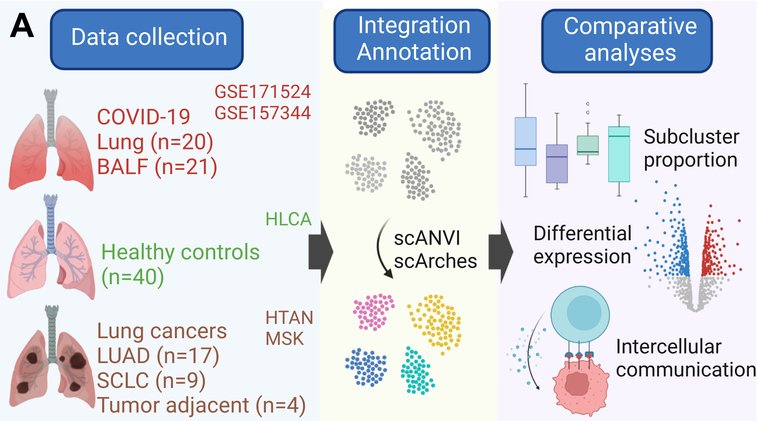
Aim and Method
We aim to use scRNA-seq datasets from lung cancers and COVID-19 to find potential molecular mechanisms underlying the association
LUAD: lung adenocarcinoma
SCLC: small cell lung carcinoma
HLCA: Human Lung Cell Atlas
HTAN: Human Tumor Atlas Network
MSK: Memorial Sloan Kettering

Slide 4
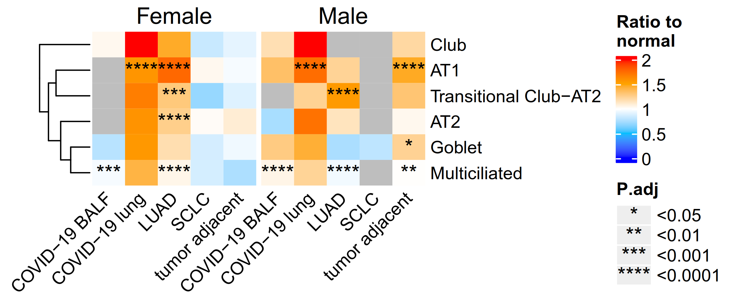
Upregulated TMPRSS2 expression in lung adenocarcinoma epithelial cells
TMPRSS2: priming/activating SARS-CoV-2 spike protein
TMPRSS2 expression increases in both female and male LUAD patients
Increased risk of viral entry

Slide 5
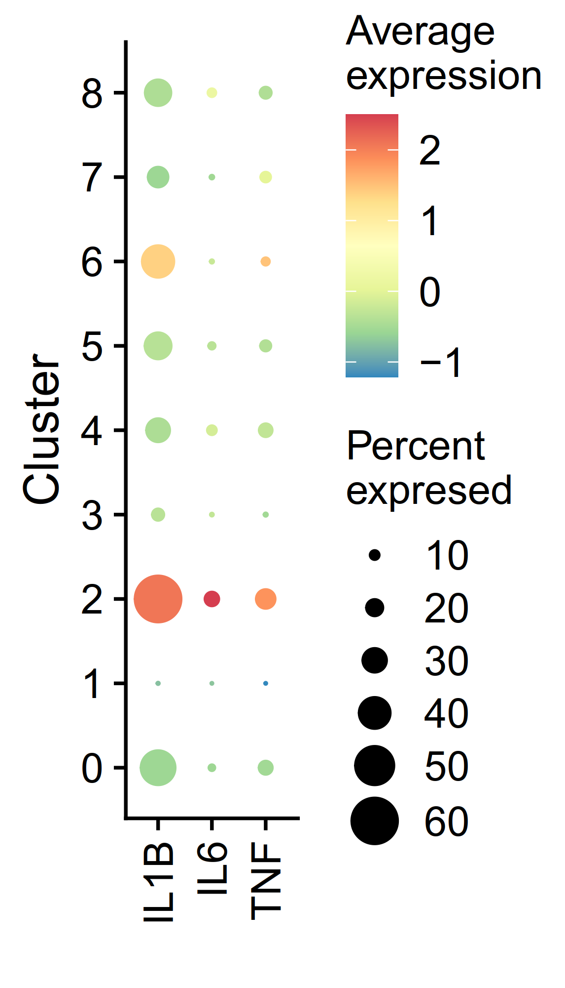
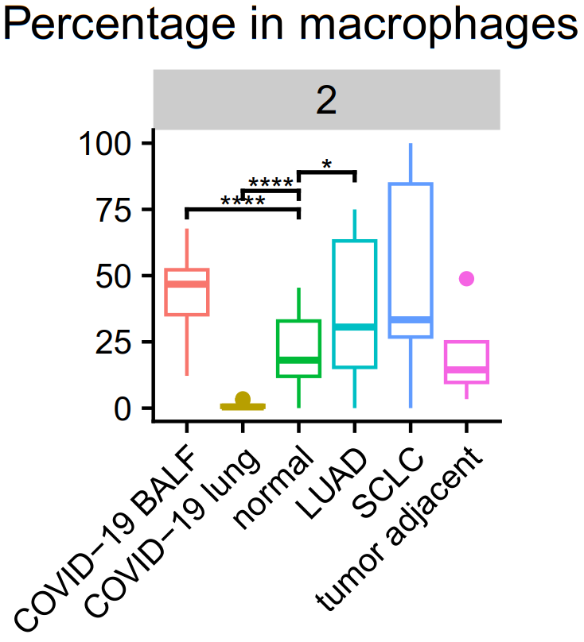
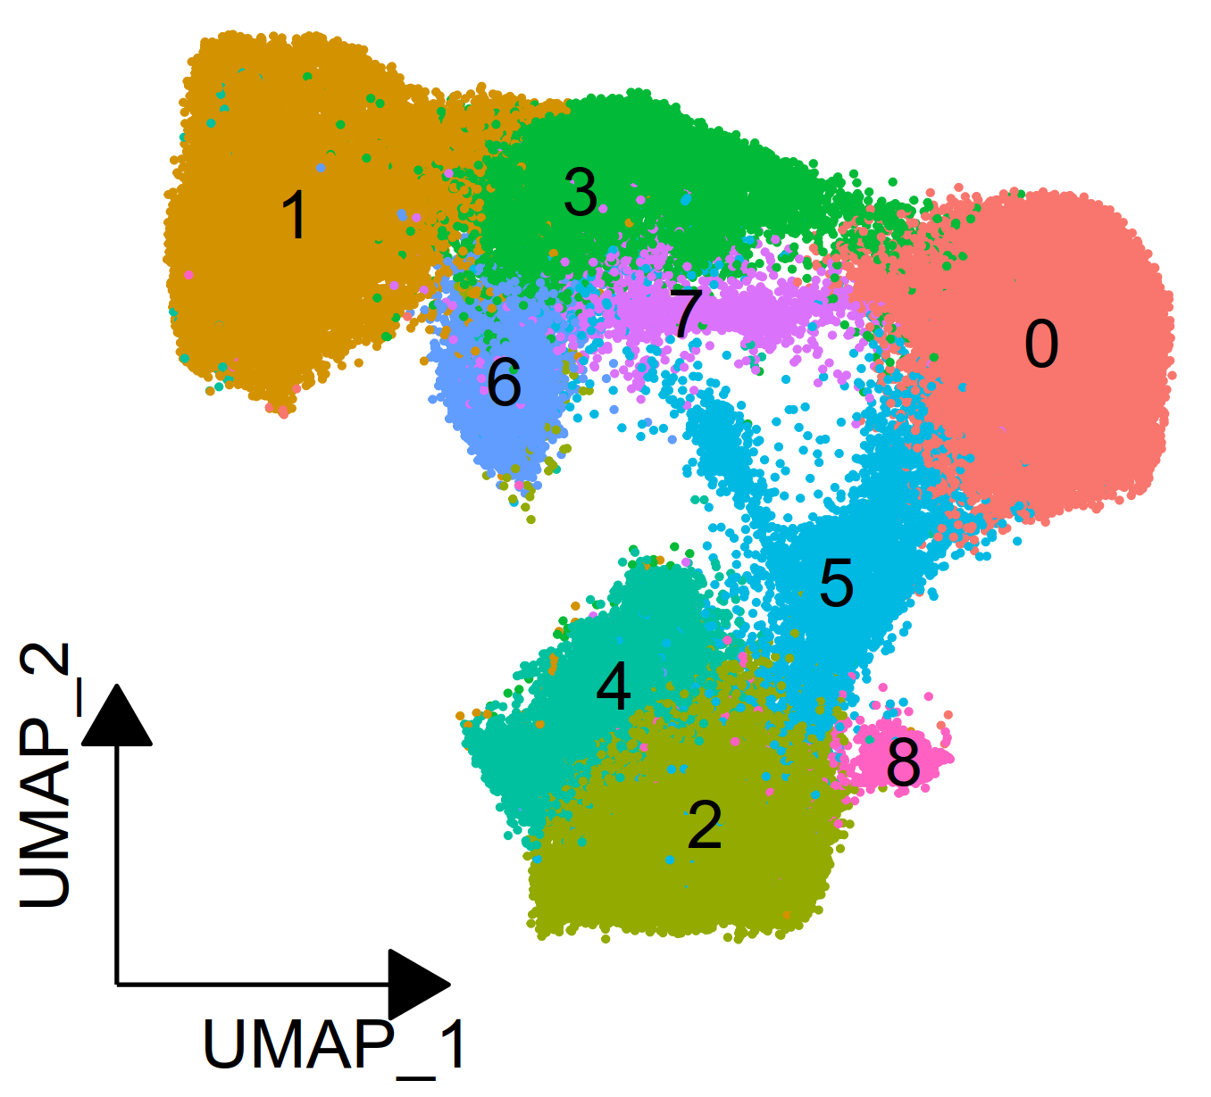
IL1B+ proinflammatory macrophages are enriched in COVID-19 lung and lung cancers
Excessive inflammation is a hallmark of severe COVID-19
Macrophage cluster 2 has high expression of IL1B and other proinflammatory cytokines

Slide 6
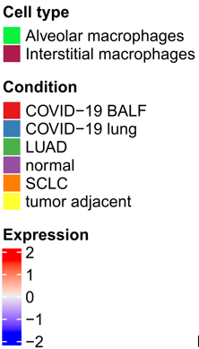
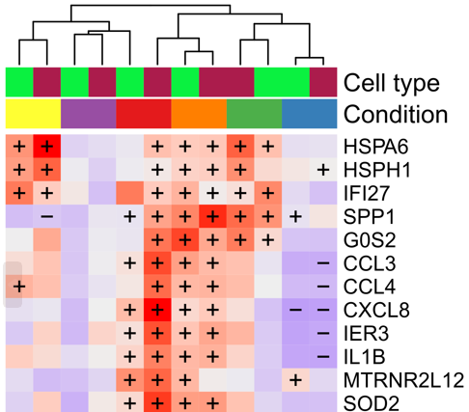
Upregulated proinflammatory genes in COVID-19 lung and lung cancers
Inflammatory genes:
IL1B
CCL3, CCL4, CXCL8
SPP1
Pre-existing proinflammatory signaling in lung cancers could exacerbate hyperinflammation and tissue damage
COVID-19 BALF
SCLC
LUAD
Increased risk of hyperinflammation

Slide 7
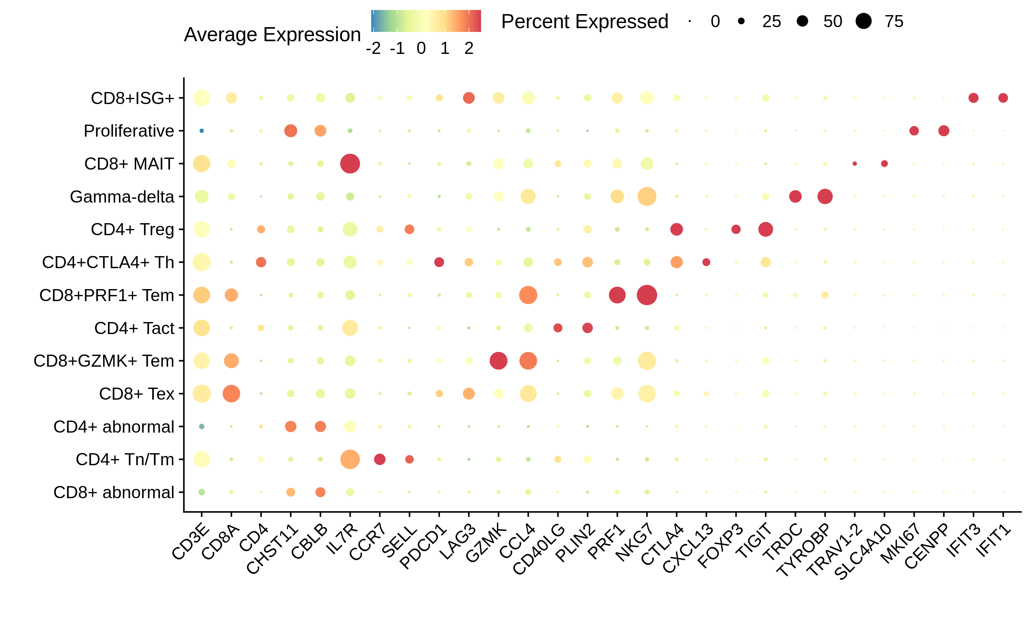
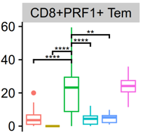
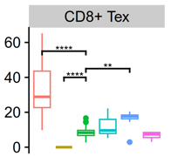
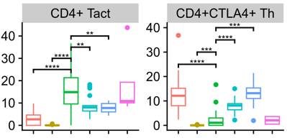

Inhibitory and exhausted T cells are enriched in COVID-19 lung and lung cancers
More exhausted CD8+ T cells in lung cancer and COVID-19
More suppressive CD4+ T cells in lung cancer and COVID-19

Slide 8
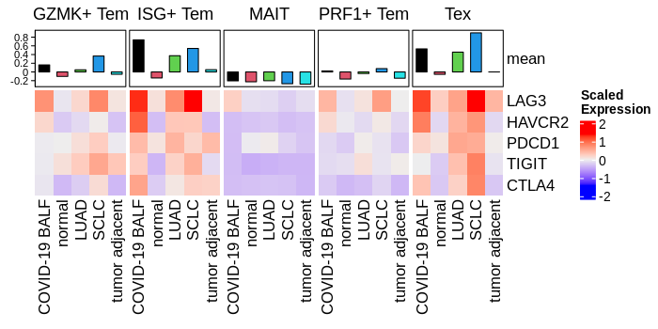
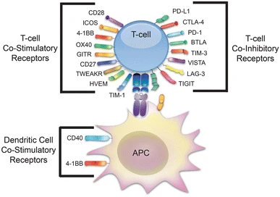
Effector T cells display a more exhausted phenotype in COVID-19 lung and lung cancers
Increased expression of co-inhibitory receptors on CD8+T cell subpopulations, decreased effector function
Suppressive T cell response
Ai M, Curran MA. Cancer Immunol Immunother. 2015

Slide 9
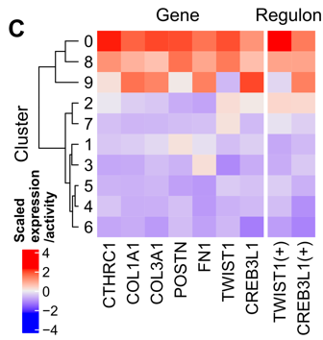
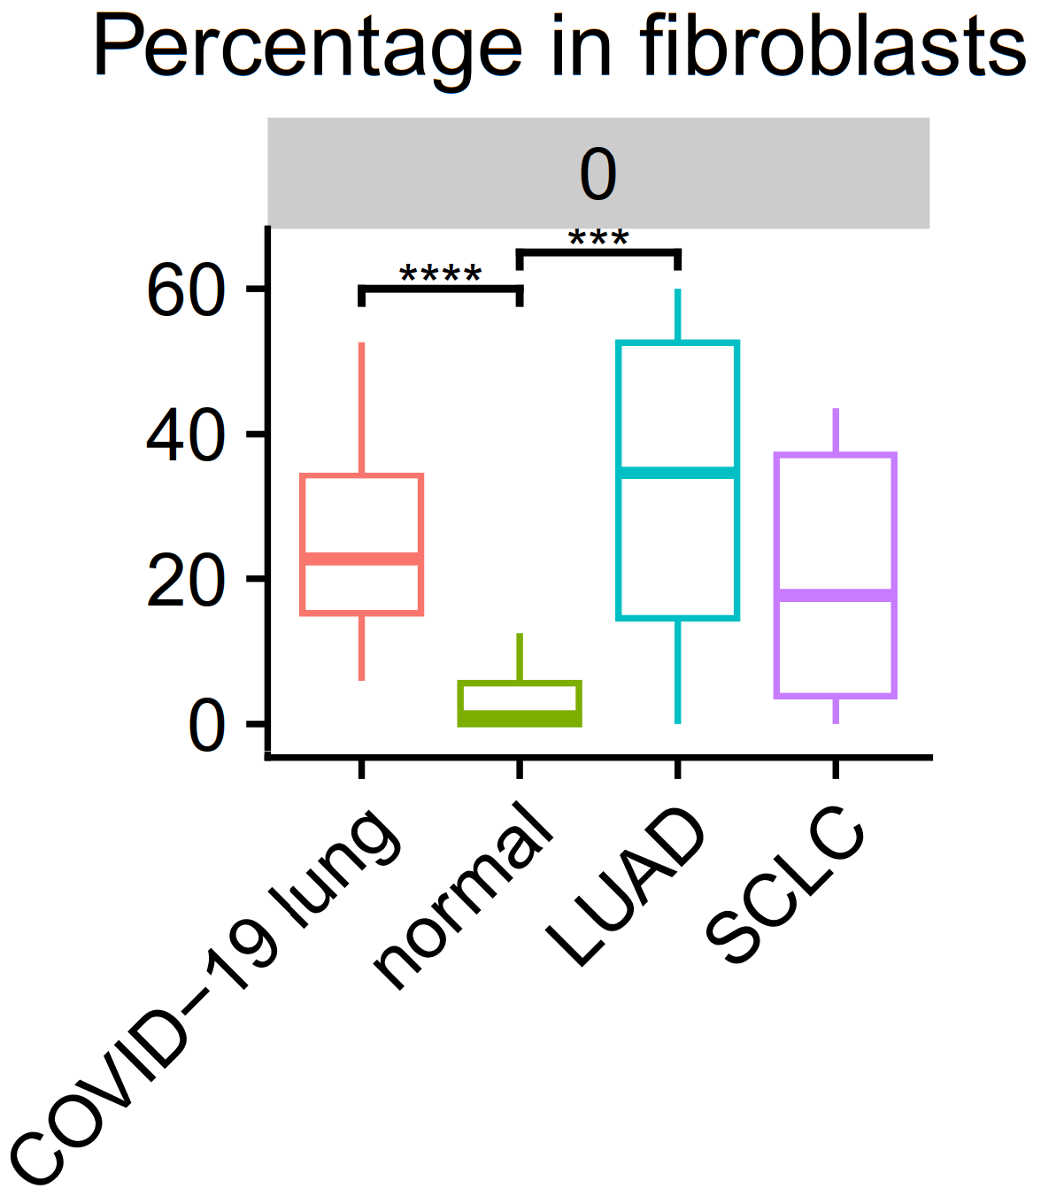
Increased pathological fibroblasts in COVID-19 lung and lung cancers
CTHRC1 is a marker gene of pathological fibroblasts (cluster 0), present in fibrotic lungs.
Two important TFs identified using pySCENIC: TWIST1, CREB3L1
TWIST1: regulator of the pro-fibrotic effects of TGFB in fibroblasts
CREB3L1: induced by TGFB, essential for collagen production
Tsukui et al. Nat Comm. 2020
Palumbo-Zerr et al. Ann Rheum Dis. 2017
Chen et al. PLoS One. 2014

Slide 10
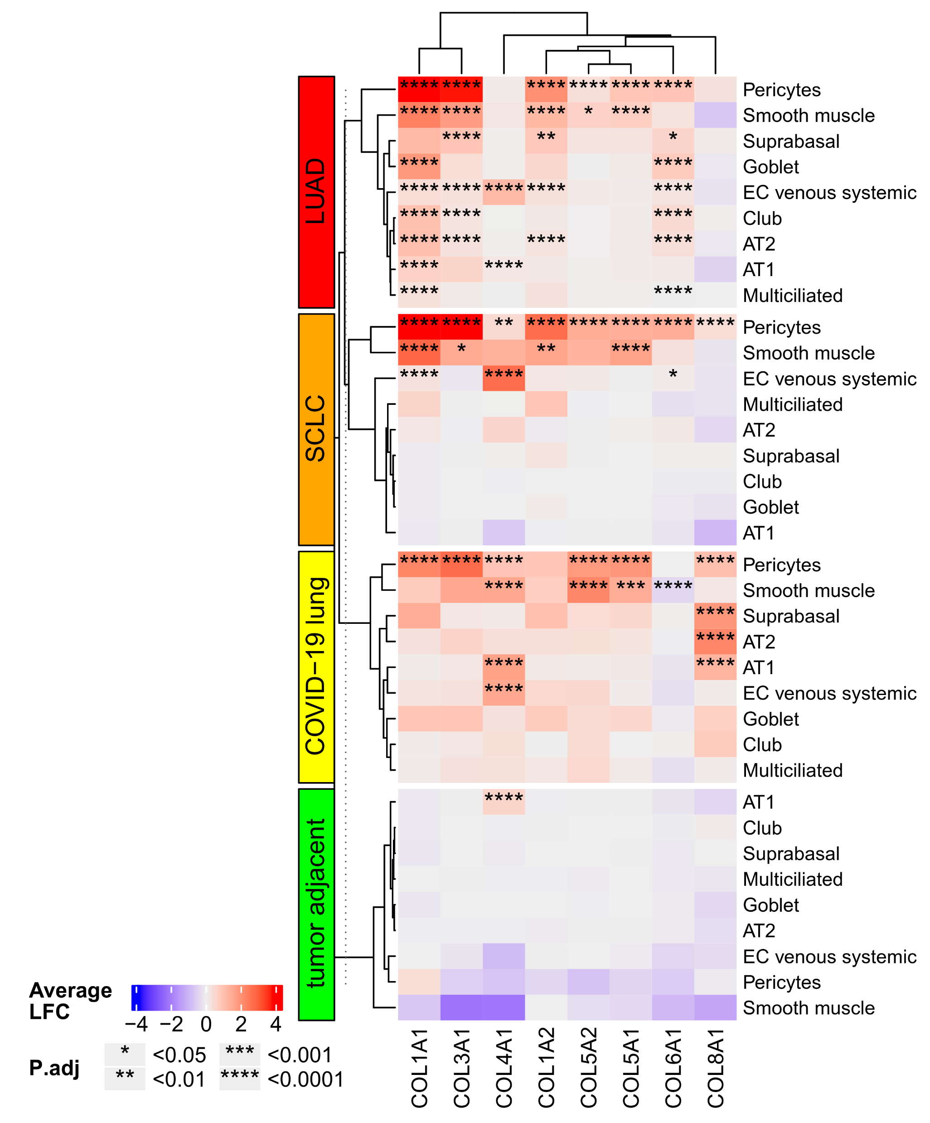
Upregulated collagen production in other cells
Excessive accumulation of collagens is a characteristic of fibrosis
Upregulated collagen production by mesenchymal, epithelial and endothelial cells in lung cancers and COVID-19
Increased risk of fibrosis

Slide 11
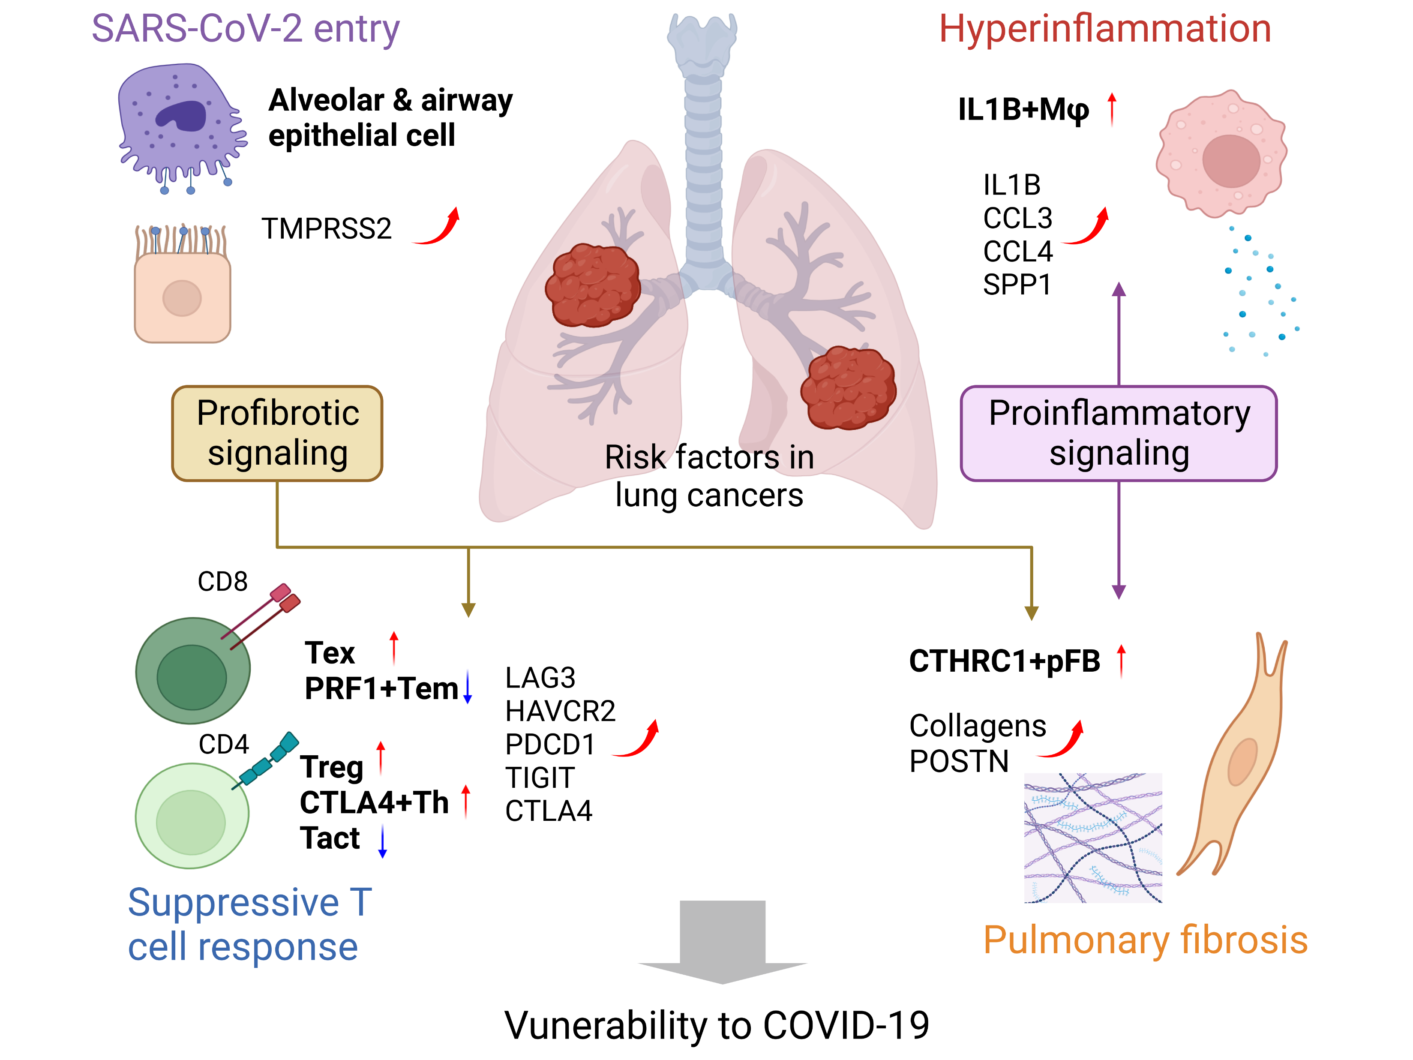
Summary
By integrative analysis of scRNA-seq data from lung cancers and COVID-19 patients, we identified several potential molecular mechanisms making lung cancer patients more vulnerable to COVID-19
Published at:
Liu et al. Mol Cancer Res. 2024. 10.1158/1541-7786.MCR-23-0692

Slide 12
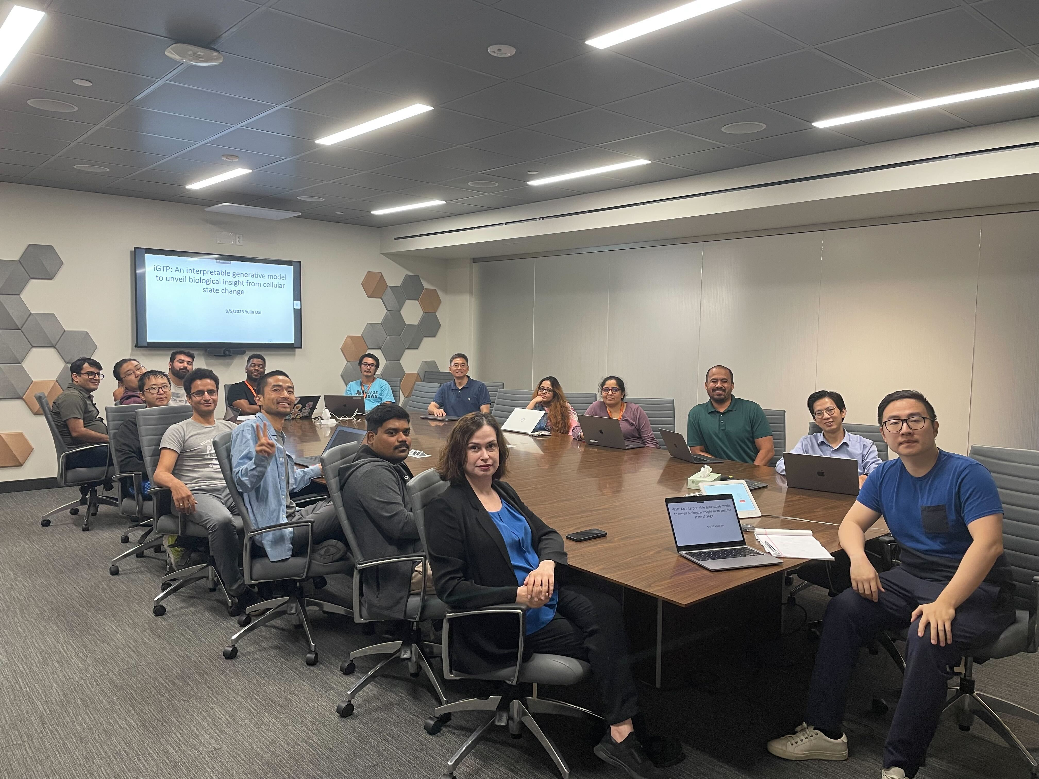

Acknowledgement
Dr. Zhongming Zhao and lab members
Co-mentor Dr. Wenbo Li
Support from CPRIT BIG-TCR predoctoral fellowship

